Slide 1
Basic Tree Concepts
A tree consists of finite set of elements, called nodes, and a finite set of directed lines called branches, that connect the nodes.
The number of branches associated with a node is the degree of the node.
Data Structures: A Pseudocode Approach with C

Slide 2
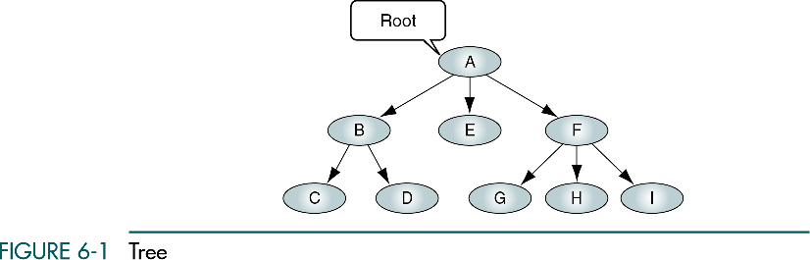
Data Structures: A Pseudocode Approach with C

Slide 3
Basic Tree Concepts
When the branch is directed toward the node, it is indegree branch.
When the branch is directed away from the node, it is an outdegree branch.
The sum of the indegree and outdegree branches is the degree of the node.
If the tree is not empty, the first node is called the root.
Data Structures: A Pseudocode Approach with C

Slide 4
Basic Tree Concepts
The indegree of the root is, by definition, zero.
With the exception of the root, all of the nodes in a tree must have an indegree of exactly one; that is, they may have only one predecessor.
All nodes in the tree can have zero, one, or more branches leaving them; that is, they may have outdegree of zero, one, or more.
Data Structures: A Pseudocode Approach with C

Slide 5
Data Structures: A Pseudocode Approach with C

Slide 6
Basic Tree Concepts
A leaf is any node with an outdegree of zero, that is, a node with no successors.
A node that is not a root or a leaf is known as an internal node.
A node is a parent if it has successor nodes; that is, if it has outdegree greater than zero.
A node with a predecessor is called a child.
Data Structures: A Pseudocode Approach with C

Slide 7
Basic Tree Concepts
Two or more nodes with the same parents are called siblings.
An ancestor is any node in the path from the root to the node.
A descendant is any node in the path below the parent node; that is, all nodes in the paths from a given node to a leaf are descendants of that node.
Data Structures: A Pseudocode Approach with C

Slide 8
Basic Tree Concepts
A path is a sequence of nodes in which each node is adjacent to the next node.
The level of a node is its distance from the root. The root is at level 0, its children are at level 1, etc. …
Data Structures: A Pseudocode Approach with C

Slide 9
Basic Tree Concepts
The height of the tree is the level of the leaf in the longest path from the root plus 1. By definition the height of any empty tree is -1.
A subtree is any connected structure below the root. The first node in the subtree is known is the root of the subtree.
Data Structures: A Pseudocode Approach with C

Slide 10
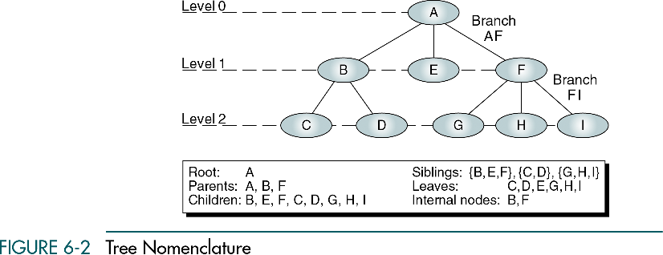
Data Structures: A Pseudocode Approach with C

Slide 11
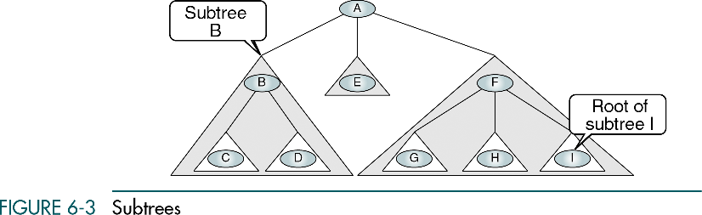
Data Structures: A Pseudocode Approach with C

Slide 12
Recursive definition of a tree
A tree is a set of nodes that either:
is empty or
has a designated node, called the root, from which hierarchically descend zero or more subtrees, which are also trees.
Data Structures: A Pseudocode Approach with C

Slide 13
Tree Representation
General Tree – organization chart format
Indented list – bill-of-materials system in which a parts list represents the assembly structure of an item
Data Structures: A Pseudocode Approach with C

Slide 14
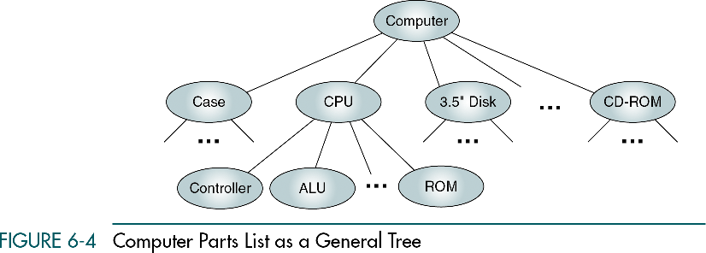
Data Structures: A Pseudocode Approach with C

Slide 15
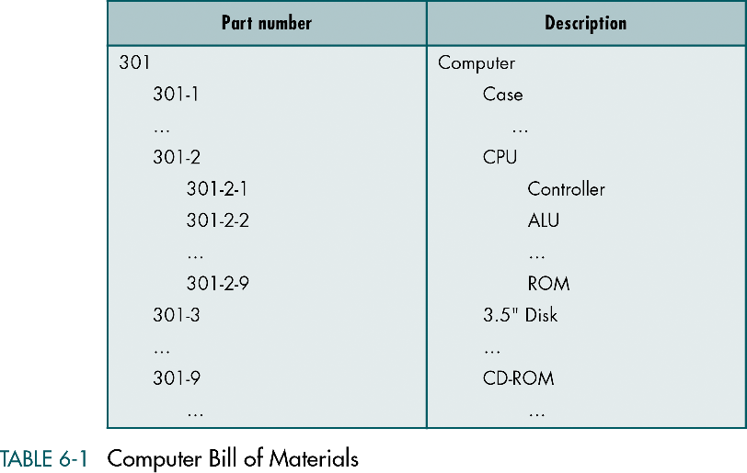
Data Structures: A Pseudocode Approach with C

Slide 16
Parenthetical Listing
Parenthetical Listing – the algebraic expression, where each open parenthesis indicates the start of a new level and each closing parenthesis completes the current level and moves up one level in the tree.
Data Structures: A Pseudocode Approach with C

Slide 17
Parenthetical Listing
A (B (C D) E F (G H I) )
Data Structures: A Pseudocode Approach with C

Slide 18
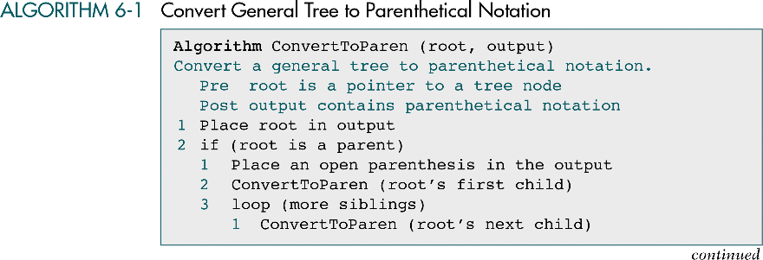
Data Structures: A Pseudocode Approach with C

Slide 19
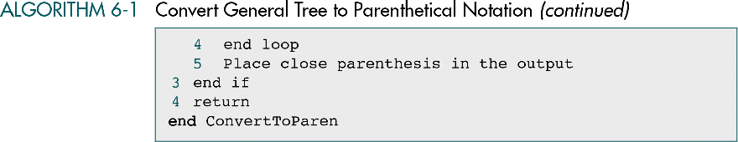
Data Structures: A Pseudocode Approach with C

Slide 20
6-2 Binary Trees
A binary tree can have no more than two descendents. In this section we discuss the properties of binary trees, four different binary tree traversals
Properties
Binary Tree Traversals
Expression Trees
Huffman Code
Data Structures: A Pseudocode Approach with C

Slide 21
Binary Trees
A binary tree is a tree in which no node can have more than two subtrees; the maximum outdegree for a node is two.
In other words, a node can have zero, one, or two subtrees.
These subtrees are designated as the left subtree and the right subtree.
Data Structures: A Pseudocode Approach with C

Slide 22
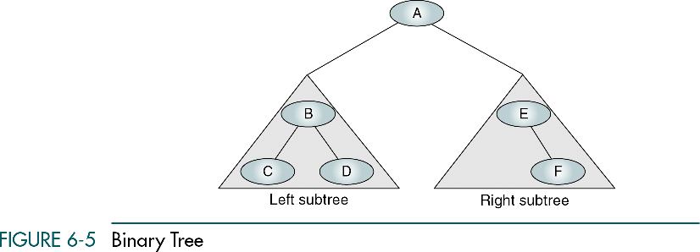
Data Structures: A Pseudocode Approach with C

Slide 23
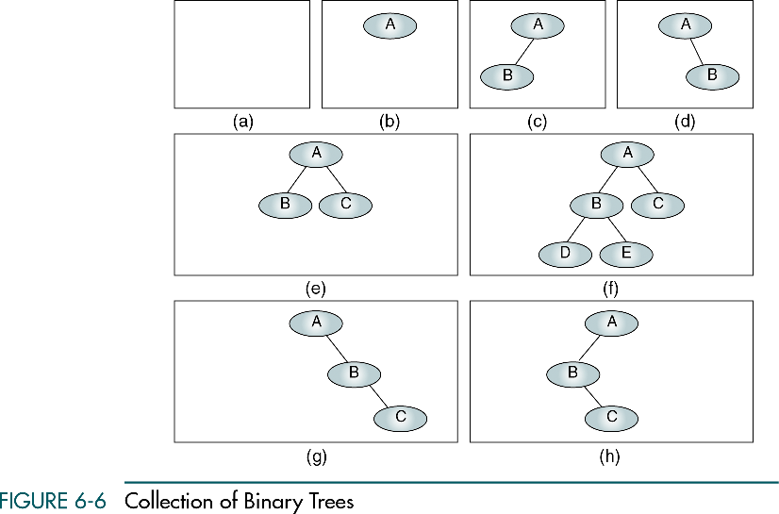
A null tree is a tree with no nodes
Data Structures: A Pseudocode Approach with C

Slide 24
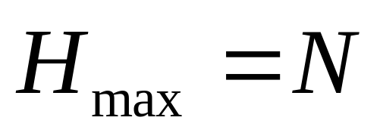
Some Properties of Binary Trees
The height of binary trees can be mathematically predicted
Given that we need to store N nodes in a binary tree, the maximum height is
A tree with a maximum height is rare. It occurs when all of the nodes in the entire tree have only one successor.
Data Structures: A Pseudocode Approach with C

Slide 25
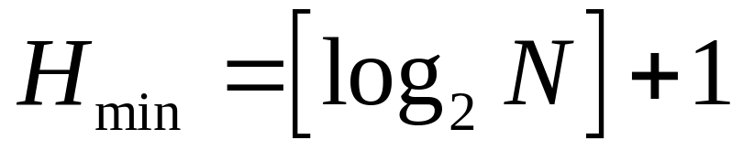
Some Properties of Binary Trees
The minimum height of a binary tree is determined as follows:
For instance, if there are three nodes to be stored in the binary tree (N=3) then H_{min}=2.
Data Structures: A Pseudocode Approach with C

Slide 26
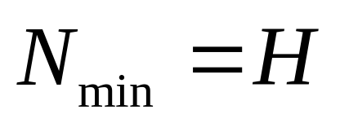
Some Properties of Binary Trees
Given a height of the binary tree, H, the minimum number of nodes in the tree is given as follows:
Data Structures: A Pseudocode Approach with C

Slide 27
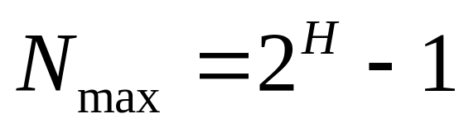
Some Properties of Binary Trees
The formula for the maximum number of nodes is derived from the fact that each node can have only two descendents. Given a height of the binary tree, H, the maximum number of nodes in the tree is given as follows:
Data Structures: A Pseudocode Approach with C

Slide 28
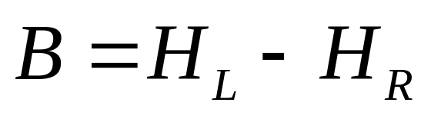
Some Properties of Binary Trees
The children of any node in a tree can be accessed by following only one branch path, the one that leads to the desired node.
The nodes at level 1, which are children of the root, can be accessed by following only one branch; the nodes of level 2 of a tree can be accessed by following only two branches from the root, etc.
The balance factor of a binary tree is the difference in height between its left and right subtrees:
Data Structures: A Pseudocode Approach with C

Slide 29
Balance of the tree
B=0
B=0
B=1
B=-1
B=0
B=1
B=-2
B=2
Data Structures: A Pseudocode Approach with C

Slide 30
Some Properties of Binary Trees
In the balanced binary tree (definition of Russian mathematicians Adelson-Velskii and Landis) the height of its subtrees differs by no more than one (its balance factor is -1, 0, or 1), and its subtrees are also balanced.
Data Structures: A Pseudocode Approach with C

Slide 31
Complete and nearly complete binary trees
A complete tree has the maximum number of entries for its height. The maximum number is reached when the last level is full.
A tree is considered nearly complete if it has the minimum height for its nodes and all nodes in the last level are found on the left
Data Structures: A Pseudocode Approach with C

Slide 32
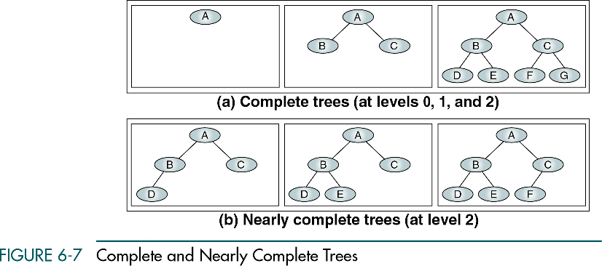
Data Structures: A Pseudocode Approach with C

Slide 33
Binary Tree Traversal
A binary tree traversal requires that each node of the tree be processed once and only once in a predetermined sequence.
In the depth-first traversal processing process along a path from the root through one child to the most distant descendant of that first child before processing a second child.
Data Structures: A Pseudocode Approach with C

Slide 34
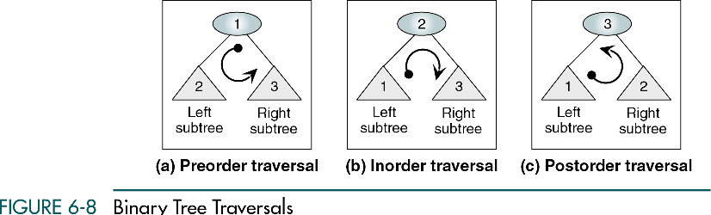
Data Structures: A Pseudocode Approach with C

Slide 35
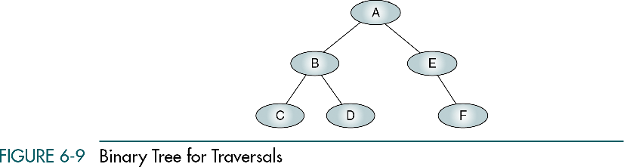
Data Structures: A Pseudocode Approach with C

Slide 36
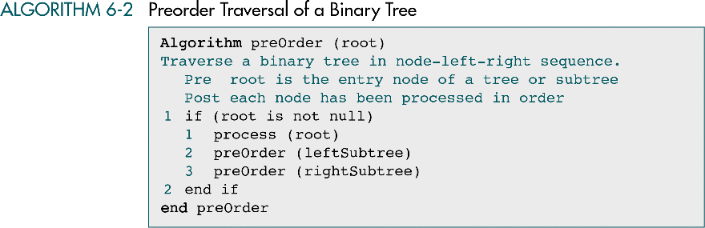
Data Structures: A Pseudocode Approach with C

Slide 37
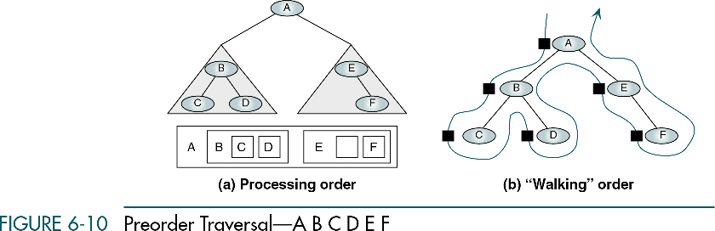
Data Structures: A Pseudocode Approach with C

Slide 38
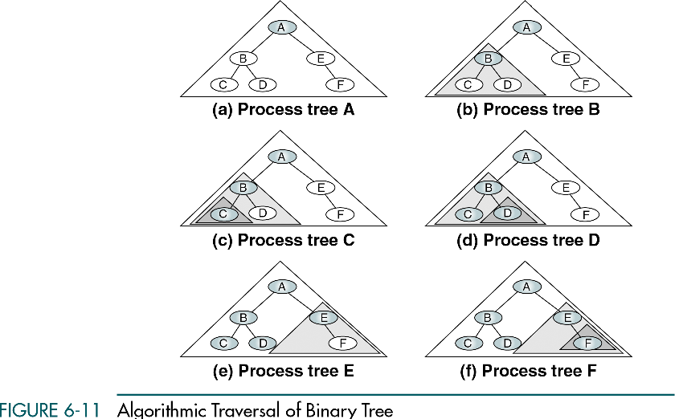
Data Structures: A Pseudocode Approach with C

Slide 39
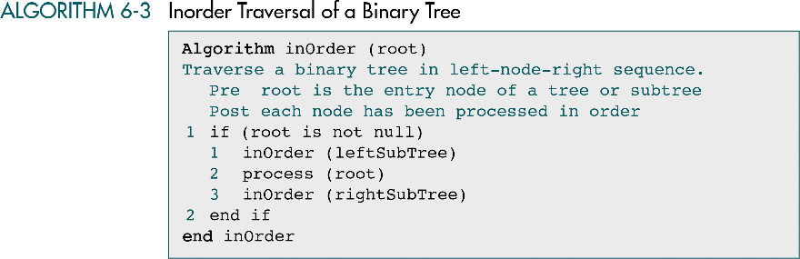
Data Structures: A Pseudocode Approach with C

Slide 40
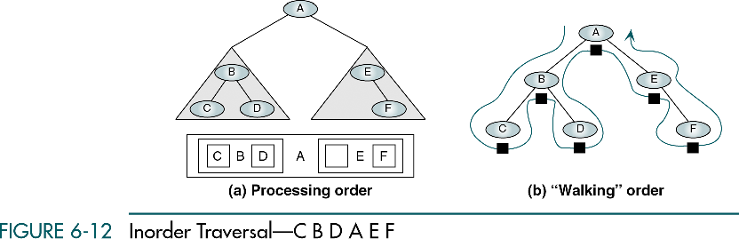
Data Structures: A Pseudocode Approach with C

Slide 41
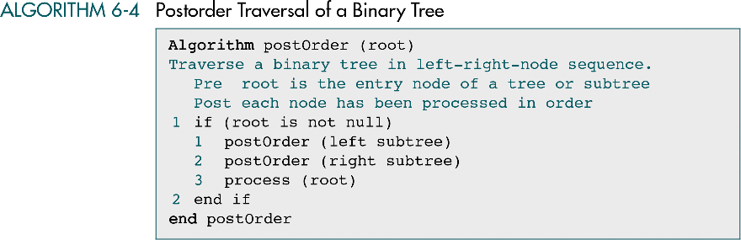
Data Structures: A Pseudocode Approach with C

Slide 42
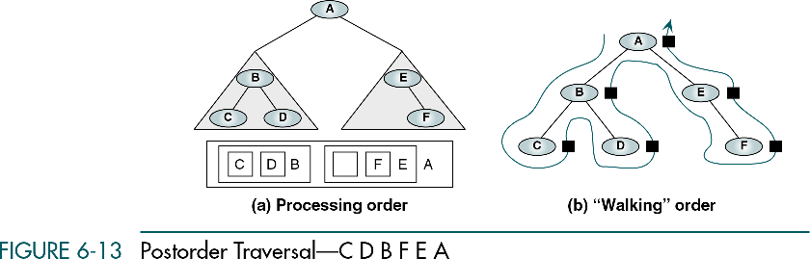
Data Structures: A Pseudocode Approach with C

Slide 43
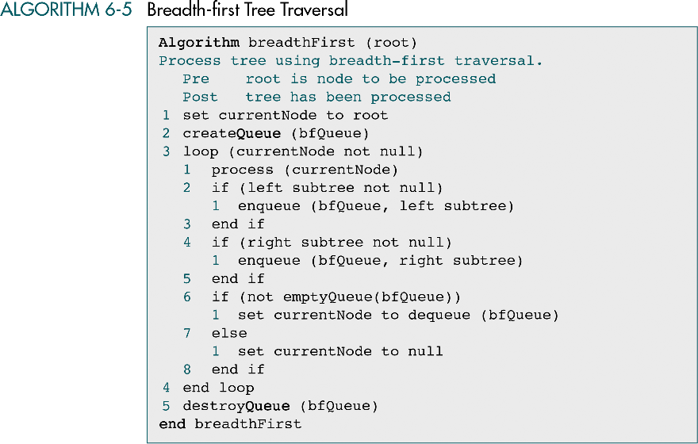
Data Structures: A Pseudocode Approach with C

Slide 44
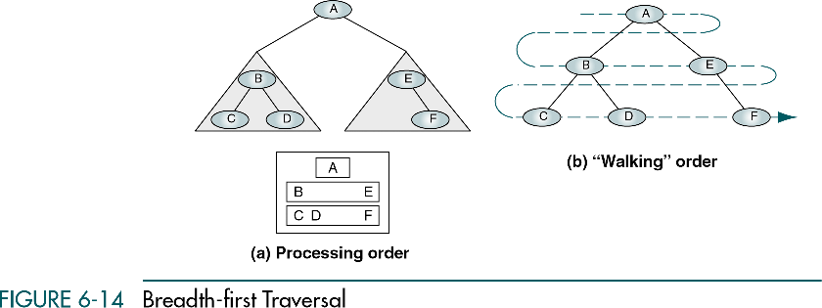
Data Structures: A Pseudocode Approach with C

Slide 45
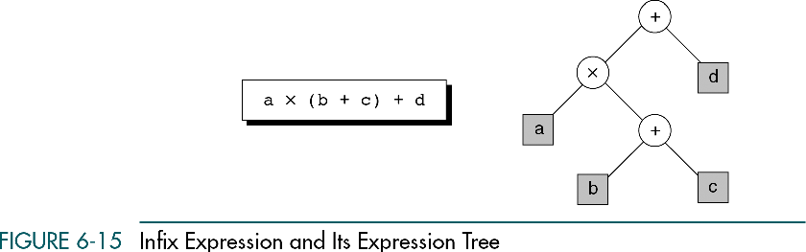
Data Structures: A Pseudocode Approach with C

Slide 46
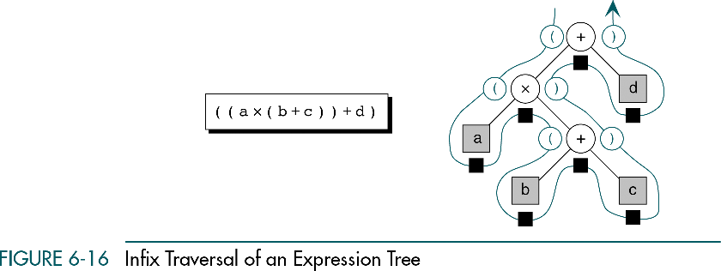
Data Structures: A Pseudocode Approach with C

Slide 47
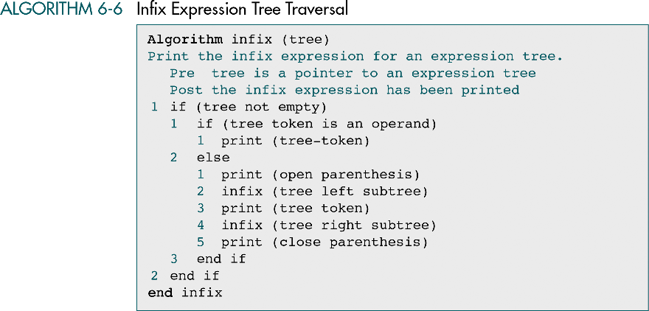
Data Structures: A Pseudocode Approach with C

Slide 48
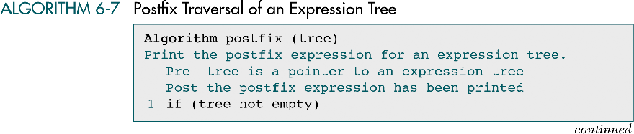
Data Structures: A Pseudocode Approach with C

Slide 49

Data Structures: A Pseudocode Approach with C

Slide 50
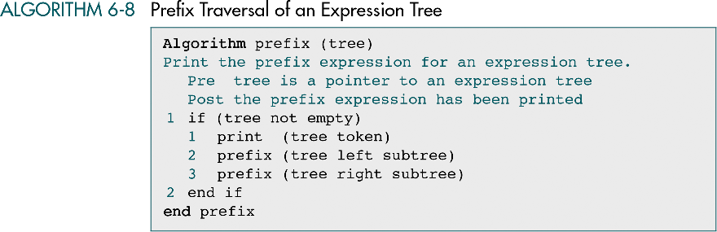
Data Structures: A Pseudocode Approach with C

